Slide 1
Formal Research Methodology
Dr. Matthew CHUA, PhD
Institute of System Science, NUS

Slide 2

About Me…
PhD, Biomedical Engineering from NUS Faculty of Engineering, Singapore
Research Interests: Artificial Intelligence, Medical Devices and Robotics
Author of over 10 peer-reviewed international journals
Associate Editor of IEEE Access Journal

Slide 3
Doing a literature search
Portals:
Google Scholar *** most popular and best in my opinion***
Science Direct
Pubmed
Type in various combinations of search fields to widen up your search
Modelling of | Hybrid | Deep | Learning | For Motion Tracking
Algorithm for | Integrated | Machine | Learning | For image Processing
Computation methods for | Augmented | Neural | Networks | For machine vision

Slide 4
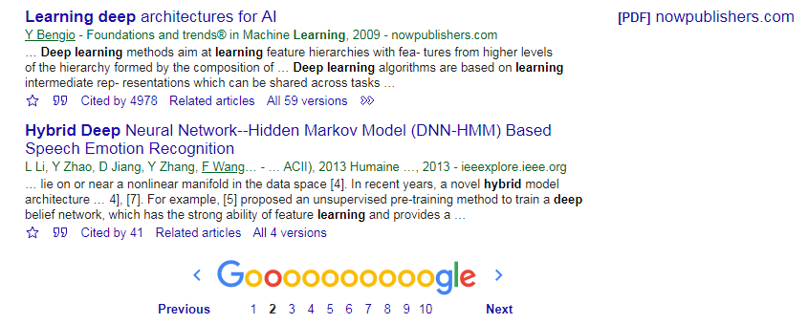
Doing a literature search
Open access journal
PDF Readily Available
Need to log in to access
article
Click this to
Download citation to your citation manager “Endnote” or Latex

Slide 5
Accessing Closed Access journal
Insert “.libproxy1.nus.edu.sg” after the first phrase and before the first slash
i.e http://ieeexplore.ieee.org/abstract/document/6681449/
Now becomes
http://ieeexplore.ieee.org.libproxy1.nus.edu.sg/abstract/document/6681449/
Log in with your NUS username and password when prompted
And viola!

Slide 6
General Rule of Thumb
Do intensive literature review of many articles ( perhaps 40 or more ?) to understand the current state of the art before you start your work!
You don’t want to do what others have already done
Try limit your searches ( via left column option) to last 5 years first, then slowly increasing the length of duration to 10 and more.
Time is precious, you can quickly browse through the journals instead of reading everything. Only focus on those which you are going to base your work on!

Slide 7
Parts of a Journal Refer to my publications for the GOLD standard
Title
The important part which gives the first impression!
To be covered later on how to construct a “scientific title”
Abstract
A summary of what is in every section. To be kept succinct and short
Introduction
Start of with background of the case
Do a literature review of current works and their LIMITATIONS
Describe briefly how your work will address these limitations and how it is novel
Every line in your introduction must be accompanied by a citation!

Slide 8
Parts of a Journal
Methods and Materials
Model development: Step by step on how you develop and derive your model. Fastest way is to take the models from several other journals and mix and integrate them together to form your “own” model
Important to include mathematical equations to make it look professional
Design of Prototype/Device (if applicable): present and describe the schematic, mechanism and software driving it
Remember to cite other journals when you use their materials
Experiment/Computational Simulation
Describe and present the setup and data and conditions used in your experiment or simulation to validate your proposed model/hypothesis/device

Slide 9
Parts of a Journal
Results
Present the results clearly. If multiple runs, include standard deviations or error bars and averages… etc etc.
Discussion and Conclusion
Discussion the implications of your results and findings. I.e how is it going to impact the current field ( good to cite other works as a comparison to your results)
Discuss the limitations of your work
Perhaps your model only applies for a certain range of data? Or patients?
Discuss your proposed future work in a paragraph that will address the limitations and bring your work further
Conclusion
Recap everything that happened in your paper

Slide 10
Pointers to note for journal
Journal is always much more impactful than conference papers
Always try to aim for journals with impact factor ( IEEE, etc etc)
A decent paper will have around 40 or more citations in the reference section
An impact factor of 30 or more ( like Nature) will lend you a tenure track professor job immediately in ANY university!

Slide 11
A constitutes of a good research title?
A formal and scientific method in your approach
Avoid general titles ( E.g. development of a smart autonomous drone)

Slide 12
Which titles are GOOD?
Development of a hybrid fuzzy learning with deep learning architecture in human motion recognition
Development of a driverless car with path finding capabilities
A novel approach in the detection of human activities through vision system
A novel path finding algorithm for drones based on a Monte Carlo-Stochastic method

Slide 13
End of Lecture
ANY Questions ?

